Slide 1

Music Genre classification using Machine Learning
1.2019103522 - GOKULNATH
2.2019103588 - sugavaneshwaran
3.2019103591 - thiruchelvan

Slide 2
TABLE OF CONTENTS
Introduction
Literature Survey
Problem Statement
Objective
System Architecture
List of Modules
Evaluation Metrics
Reference

Slide 3
INTRODUCTION
Sound is represented in the form of an audio signal having parameters like frequency, decibel, bandwidth etc.
Audio signals come in various different formats which make it possible and easy for the computer to read and analyze them.
Some formats are: mp3 format, WMA (Windows Media Audio) format and wav (Waveform Audio File) format.
Companies use music classification, either to place recommendations to their customer. To determine music genres, we can use machine learning algorithms which in turn proven to be very handy in Music Analysis too.
Classification of genre can be very valuable to explain some interesting problems such as creating song references and it can also be used for survey purposes.
The concept of automatic music genre classification has become very popular in recent years as a result of the rapid growth of the digital entertainment industry.

Slide 4
LITERATURE SURVEY
S.No | Paper Title, Authors,Year | Proposed work | Algorithm used | Advantages | Limitations
1 | Anirudh Ghildiyal,Komal Singh,Sachin Sharma,2020, Music Genre Classification using Machine Learning | Using Mels spectrogram convert audio file to signal then using CNN to predict the accuarcy. | CNN | Very High accuracy in image recognition problems. | Overfitting occurs.
2 | George Tzanetakis, Perry Cook,2002, Musical Genre Classification of Audio Signals | Timbral texture, Rhythmic content and Pitch content feature | Statistical pattern recognition (SPR) | Accurately recognize shape from different angles. | Difficult to execute & it is an extremely slow method
3 | Sarfaraz Masood,2014, Genre classification of songs using neural networks | Songs can be classified in real-time and parallel architecture can be implemented on the multi-processing system. | Multi-Layer Perceptron Network(MLP) | This work can also be extended for songs that are a mixture of two genres. | Limited to classical and sufi.

Slide 5
LITERATURE SURVEY(Contd…)
S.No | Authors,Year, Paper Title | Proposed work | Algorithm used | Advantages | Limitations
4 | Glaucia M. Bressan, Beatriz C. F. de Azevedo, Elisangela Ap. S. Lizzi 2017, A Decision Tree Approach for the Musical Genres Classification | Automatic classification method for musical genres, by applying decision tree approach. | CART (Classification and Regression Tree) and C4.5 | Applying decision trees to classify musical genres automatically, considering imprecisions and fusions. | Only used for Latin musical genres.
5 | Rajib Sarkar, Nimagna Biswas,Saurajit Chakraborty,2018,Music Genre Classification Using Frequency Domain Features | Tonality feature, Pitch based feature, Timber feature | a)Support Vector Machine(SVM) b)Random forest | Effective in cases where the number of dimensions is greater than the number of samples. | a)SVM algorithm is not suitable for large data sets. b)Random forest algorithms are fast to train, but quite slow to create predictions once they are trained.
6 | Ardiansyah Dores, Fajar Masya, Hendra Prastiawan,2018, Music Genre Classification using Naive Bayes Algorithm | Short time energy, Zero crossing rate, spectral flux | Naive Bayes | Fast and can be used to make real-time predictions. | categorical variable that wasn't present in the training data set, the model will assign it zero probability and won't be able to make any predictions.

Slide 6
LITERATURE SURVEY(Contd…)
S.No | Authors,Year, Paper Title | Proposed work | Algorithm used | Advantages | Limitations
7 | Bisharad, Dipjyoti,Rabul Hussain Laskar,2019, Music Genre Recognition Using Residual Neural Networks | A RNN model proposed for genre classification which is trained on short clips of just 3 seconds duration. | Residual neural network (RNN) | Considering this ambiguous nature of the genre, the model can assign three genre labels to a music clip, with each genre associated with some probability. | Due to its recurrent nature, the computation is slow. Training of RNN models can be difficult.
8 | Yu-Huei Cheng, Pang-Ching Chang, Che-Nan Kuo,2020, CNN Approach for Music Genre Classification | MFCC to convert audio file to signal and then using CNN to predict | a)Mel spectrum b)CNN | Better at detecting differences in lower frequencies than higher frequencies | Lots of training data are required.
9 | Nirmal M R,Shajee Mohan BS,2020, Music Genre Classification using Spectrograms | classify music genre using spectrograms | CNN | Good for image recognition problems. | Large training data needed, don't encode the position and orientation of object

Slide 7
PROBLEM STATEMENT
Until now genre classification for digitally available music has been performed manually.
Thus ,techniques for automatic genre classification would be a valuable addition to the development of audio information retrieval systems for music.

Slide 8
OBJECTIVE
The objective of automating the music classification is to make the selection of songs quick and less cumbersome.
Another objective is to reach a good accuracy so that the model classifies new music into its genre correctly.
This model should be better than at least a few pre-existing models.

Slide 9
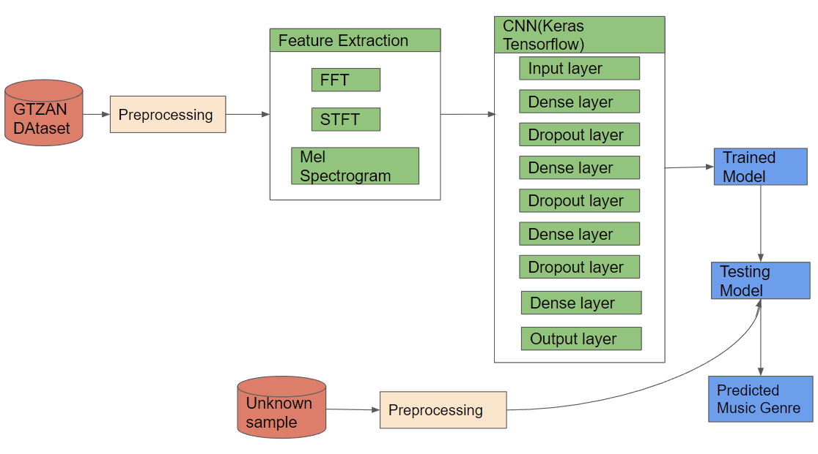
SYSTEM ARCHITECTURE

Slide 10
LIST OF MODULES
Pre processing
Feature Extraction
Training Module
Testing Module
Prediction Module

Slide 11
PRE-PROCESSING
Using Principle Component Analysis, extracting important variables (in form of components) from a large set of variables available in a data set.
It extracts low dimensional set of features from a high dimensional data set with a motive to capture as much information as possible. With fewer variables, visualization also becomes much more meaningful.
Hence, we did not suffer any major loss of information after the dimensionality reduction.

Slide 12
FEATURE EXTRACTION
STFT and MFCC Feature Extraction
Short-Term Fourier Transform (STFT):
Due to the lack of fundamental tradeoff between time and frequency, it used a short-term Fourier transform. As the name suggests “short term” means signal are split into small fixed duration of signal and then apply Fourier transform of each block. Moving the sliding to create every block in signal called framing.
To bring into real number, it evaluates the absolute value of that complex number. Now after applying (Fast Fourier Transform) FFT on each block, the resultant is called frequency representation.
Now this all frequency representation with time for this signal will be consider as their features which is also called as spectrogram.

Slide 13
FEATURE EXTRACTION(Contd…)
So, when it applied Short Term Fourier Transform (STFT) on each clip where FFT window size (frame size) is 1024 and hop length (frame increment) is 512 and windowing function is Hann function.
Mel-Frequency Cepstral Coefficient (MFCC):
Mel-Frequency Cepstral Coefficient is another representative way of spectrum of the audio clip, after compressing the frequency.
Then, apply DCT instead of Taking inverse fast Fourier transform (FFT) because it is most likely perform same as FFT and it is also easy to compute and implement.

Slide 14
TRAINING MODULE
For the CNN model, we had used the Adam optimizer for training the model.
Keras is an open-source software library that provides a Python interface for artificial neural networks.
The epoch that was chosen for the training model is 700.
All of the hidden dense layers are using the RELU activation function and the output layer uses the softmax function.
Dropout is used to prevent overfitting.
Here ,we are using 4 models for training purpose.

Slide 15
TESTING MODULE
In machine learning, model testing is referred to as the process where the performance of a fully trained model is evaluated on a testing set. The testing set consisting of a set of testing samples should be separated from the both training and validation sets, but it should follow the same probability distribution as the training set.
Each testing sample has a known value of the target. Based on the comparison of the model’s predicted value.

Slide 16
PREDICTION MODULE
Predictive modeling is used to predict future events or outcomes by analyzing patterns in a given set of input data.
The accuracy we achieved for the test set is 92.44 percent which is very decent.

Slide 17
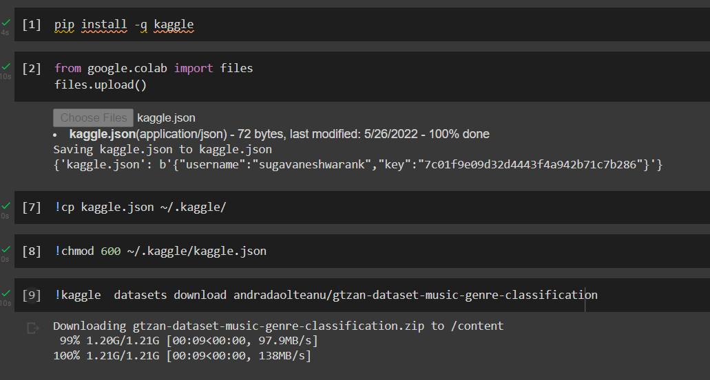
IMPLEMENTATION

Slide 18
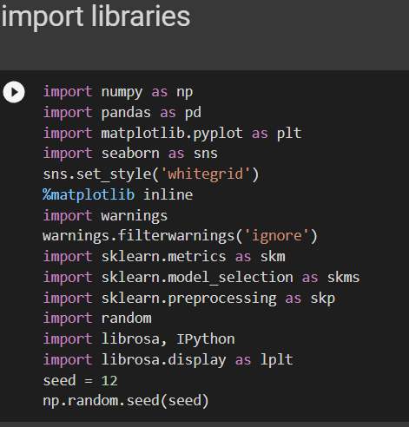
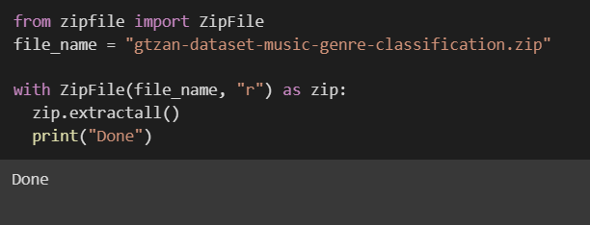
IMPORTING DATASET

Slide 19
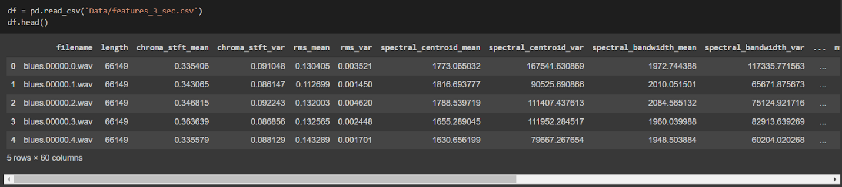
DATASET

Slide 20
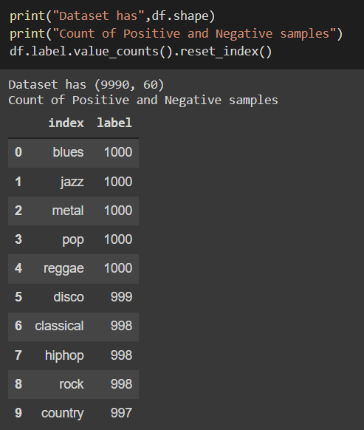
DATASET SHAPE

Slide 21
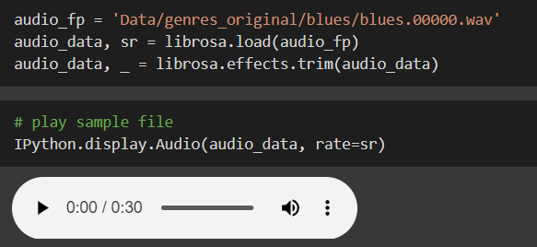
SAMPLE AUDIO FILEH

Slide 22
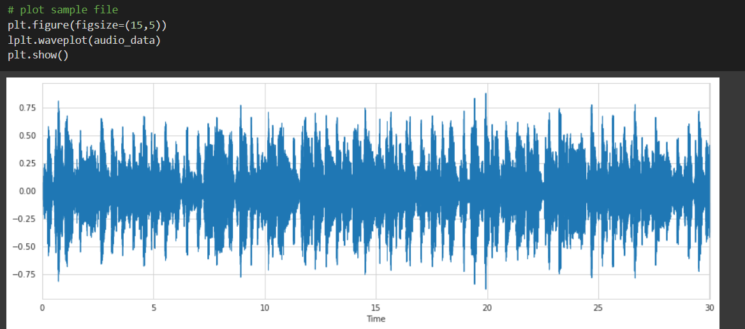
AUDIO WAVE

Slide 23
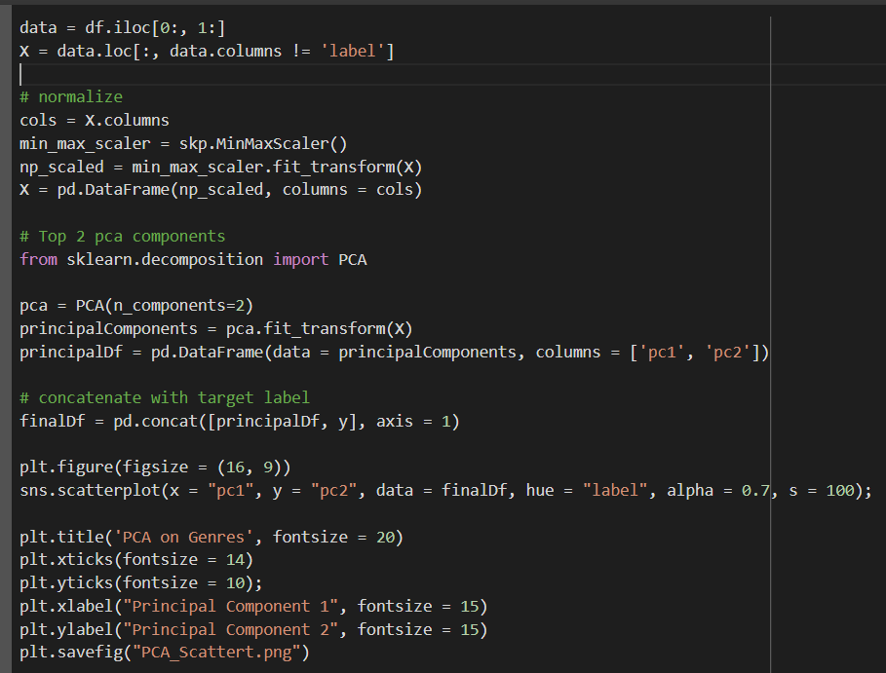
PCA

Slide 24
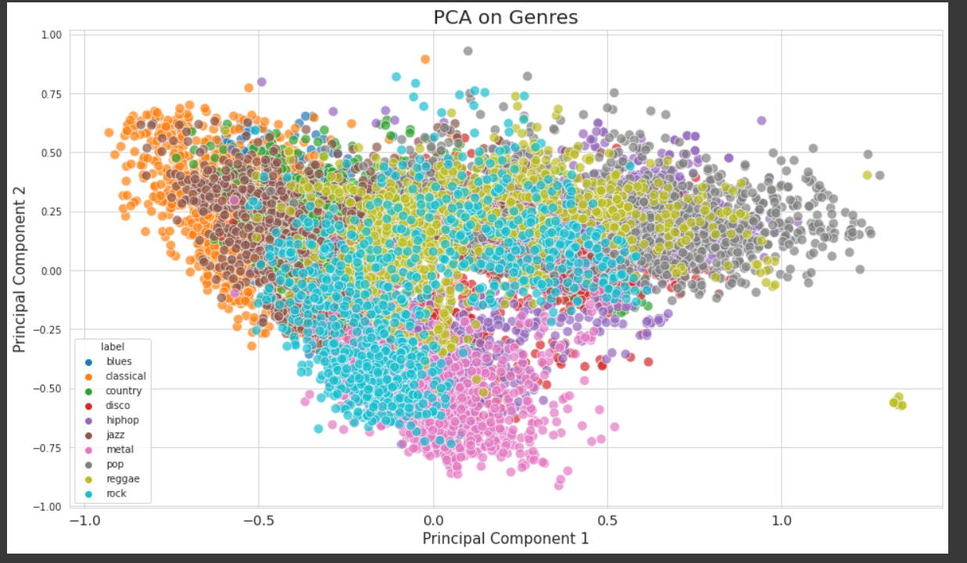

Slide 25
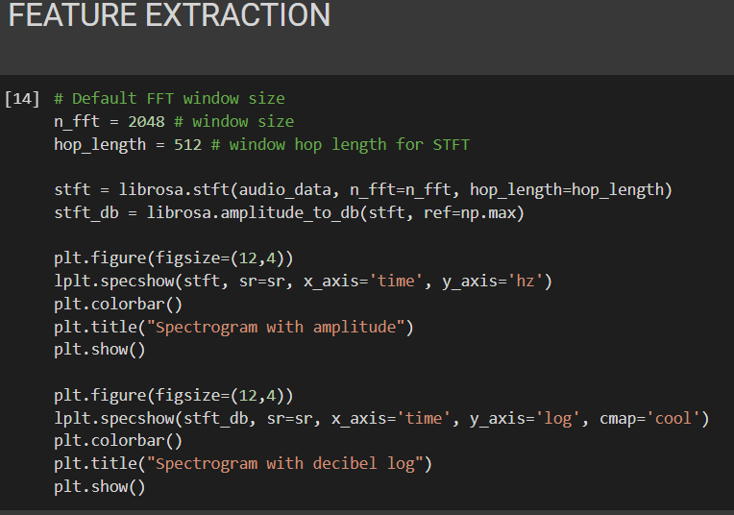
FEATURE EXTRACTION

Slide 26
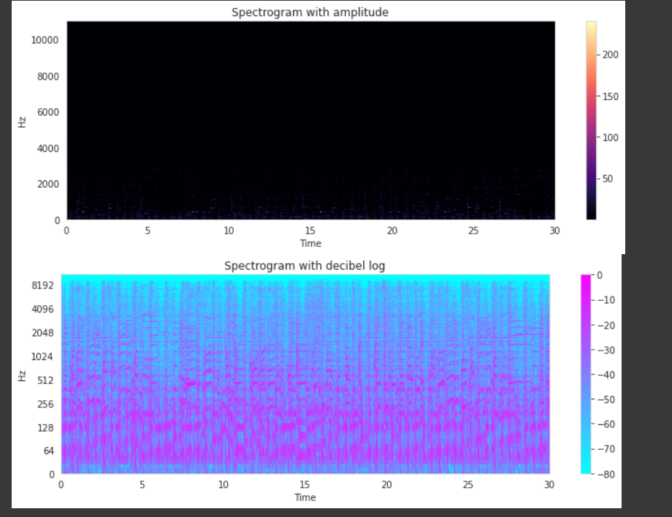
SPECTOGRAM

Slide 27
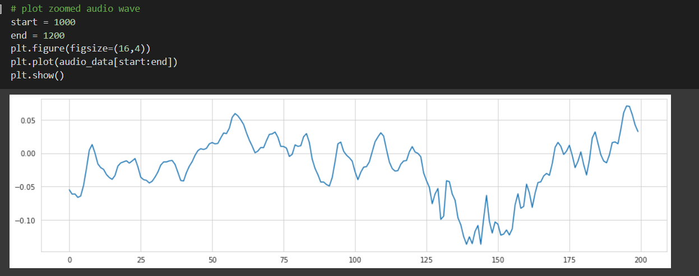
ZOOMED AUDIO WAVE

Slide 28
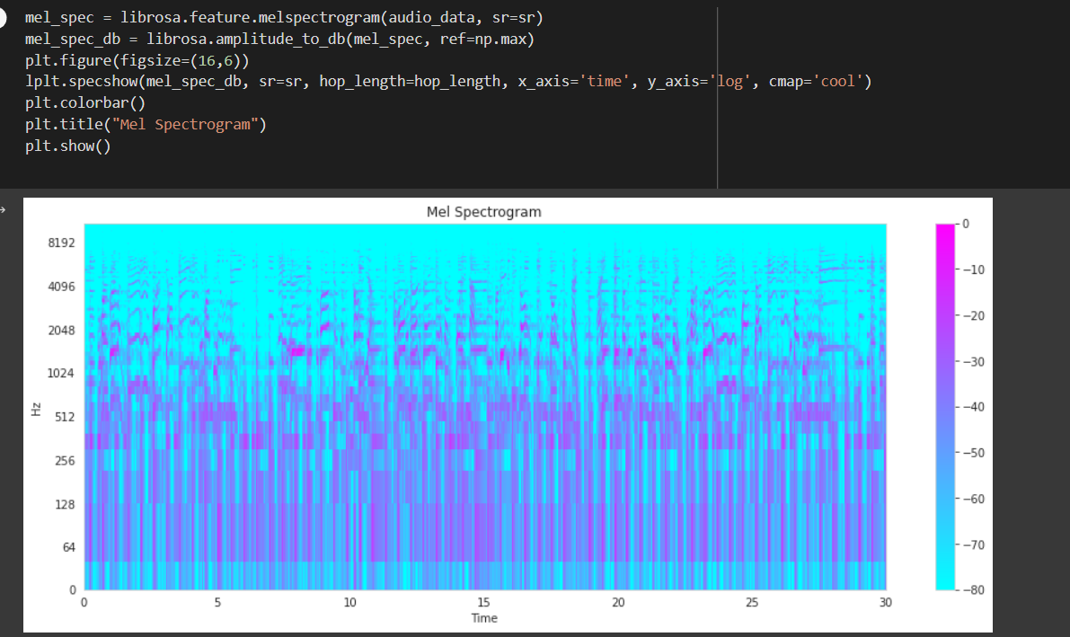
MEL SPECTOGRAM

Slide 29
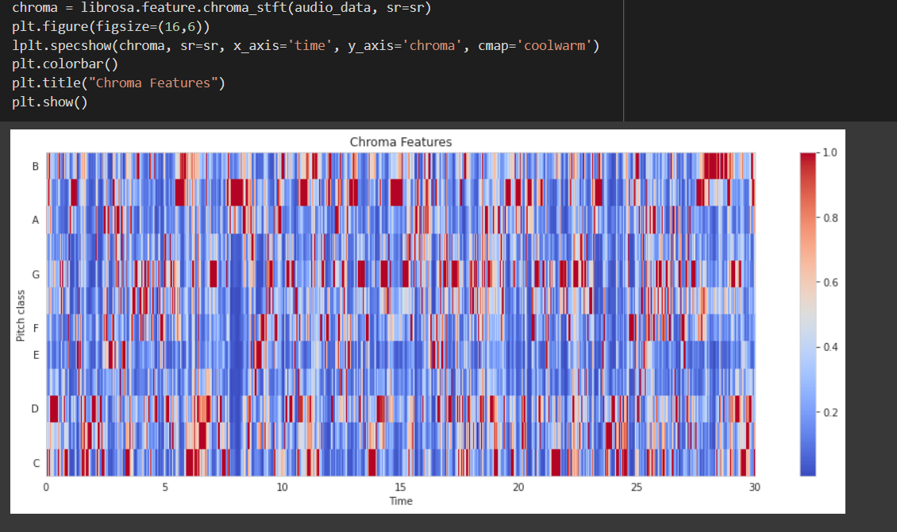
CHROMA FEATURES

Slide 30
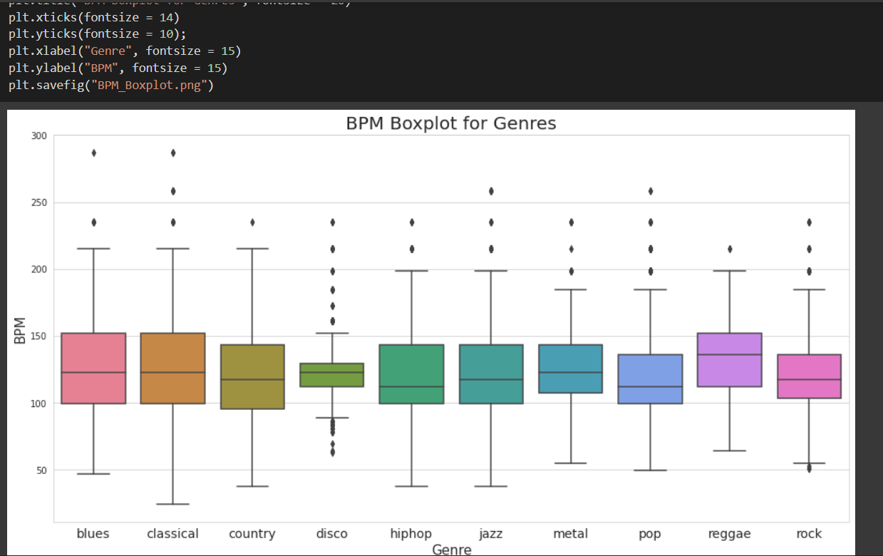
BPM

Slide 31
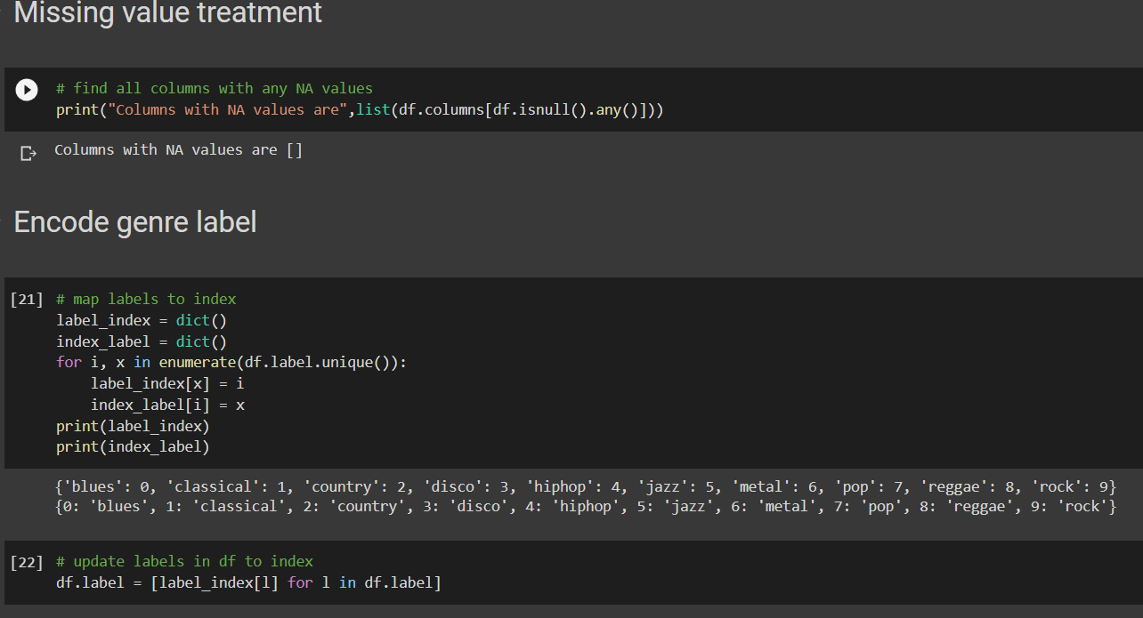
ENCODE GENRE LABEL

Slide 32
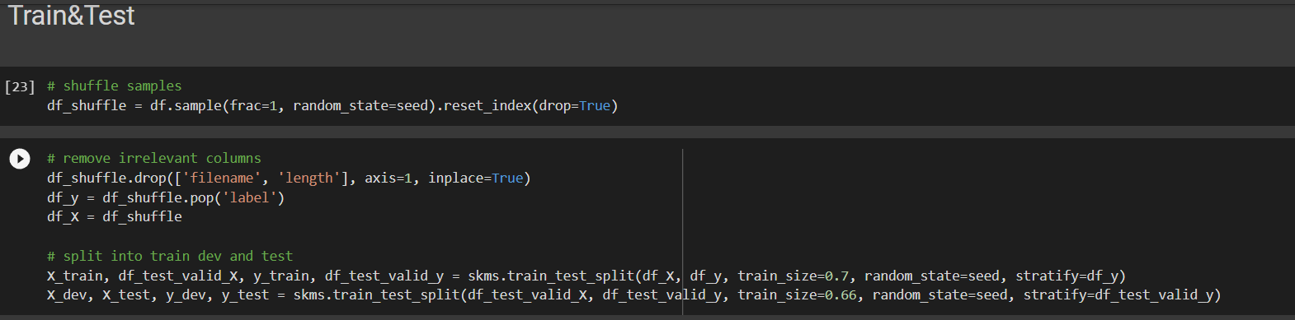
TRAIN & TEST SPLIT

Slide 33
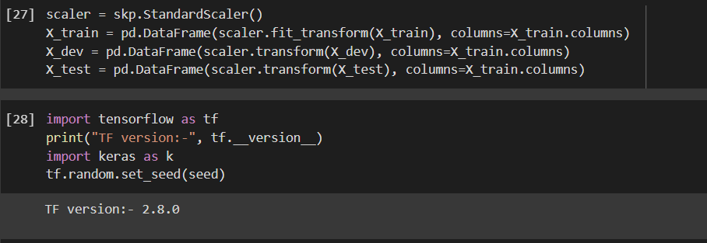
STANDARD SCALAR

Slide 34
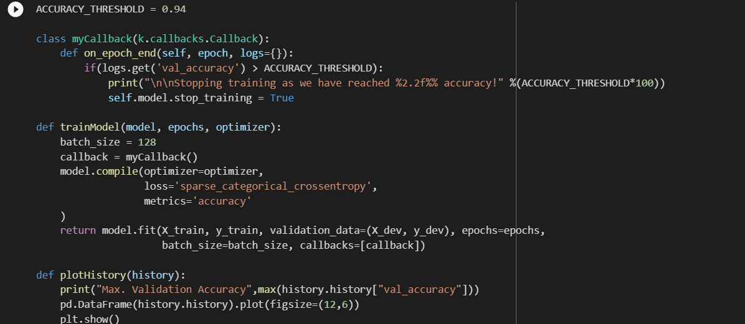
TRAINING MODULE

Slide 35
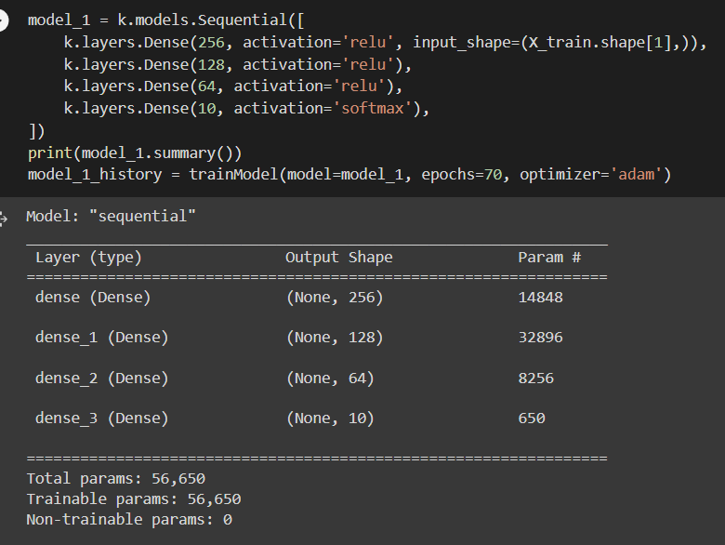
MODEL 1

Slide 36
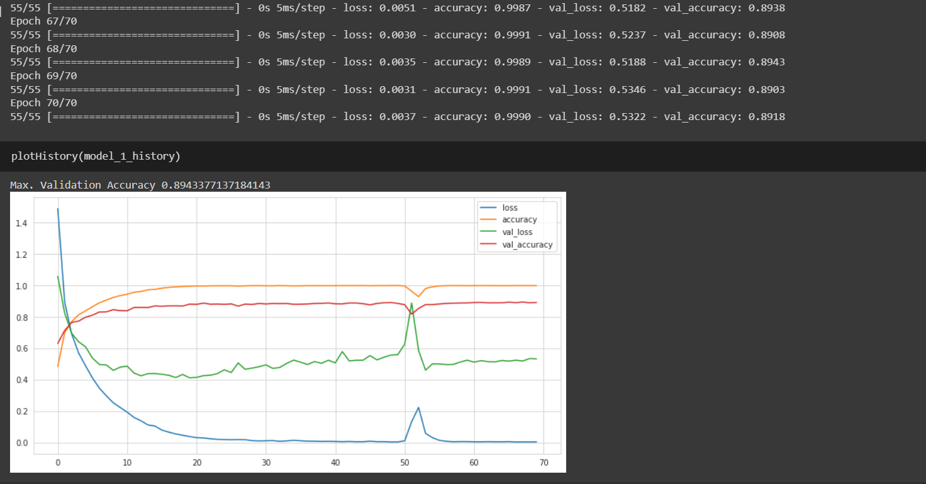
MODEL 1 ACCURACY

Slide 37
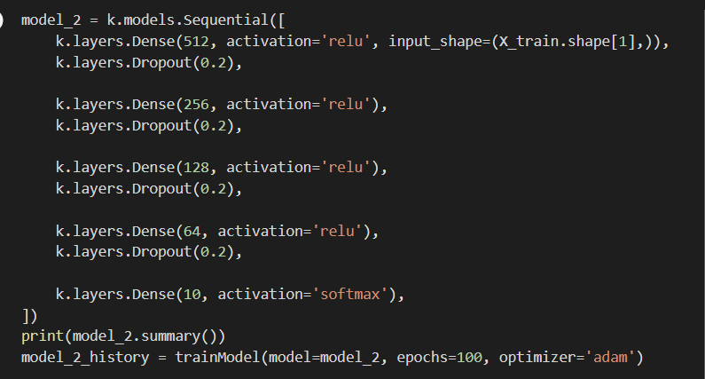
MODEL 2

Slide 38
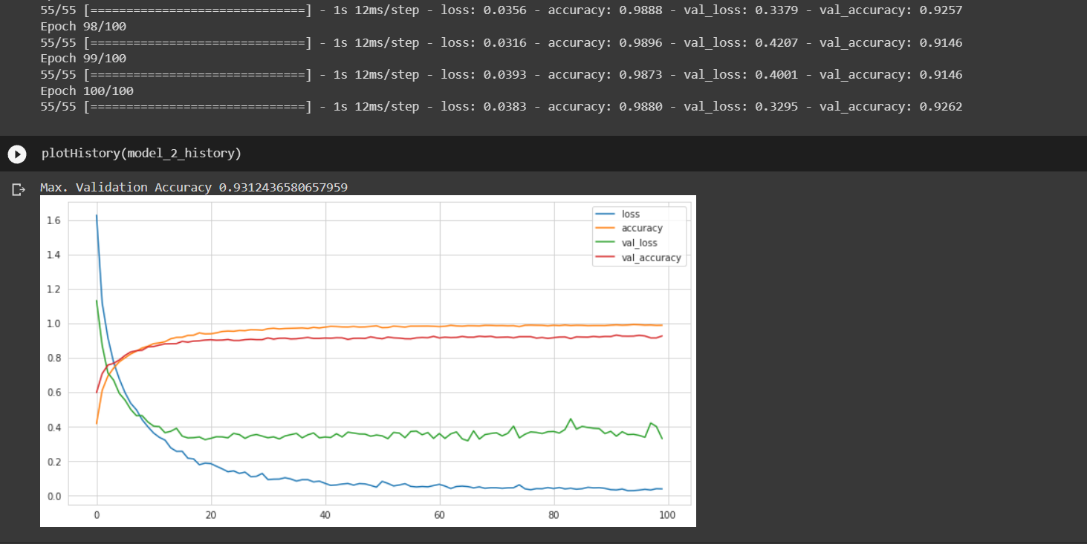
MODEL 2 ACCURACY

Slide 39
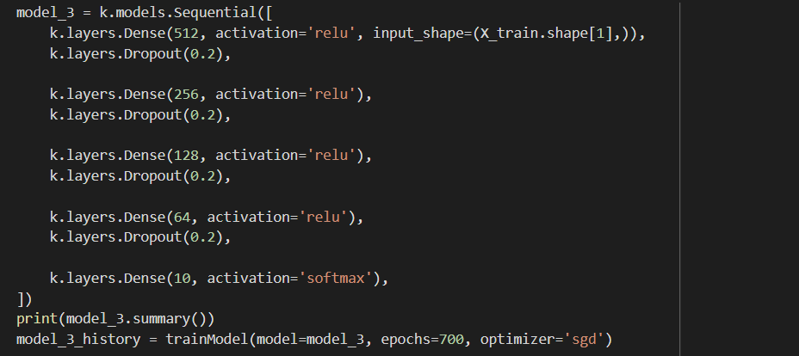
MODEL 3

Slide 40
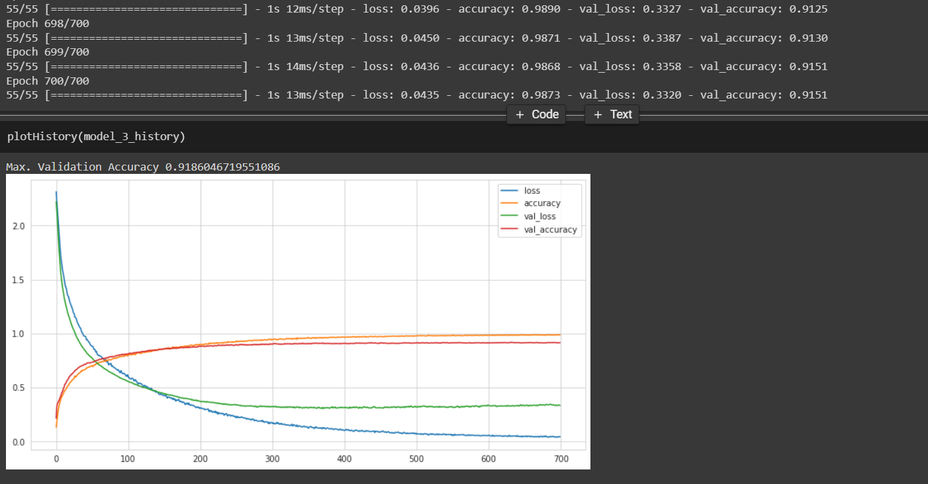
MODEL 3 ACCURACY

Slide 41
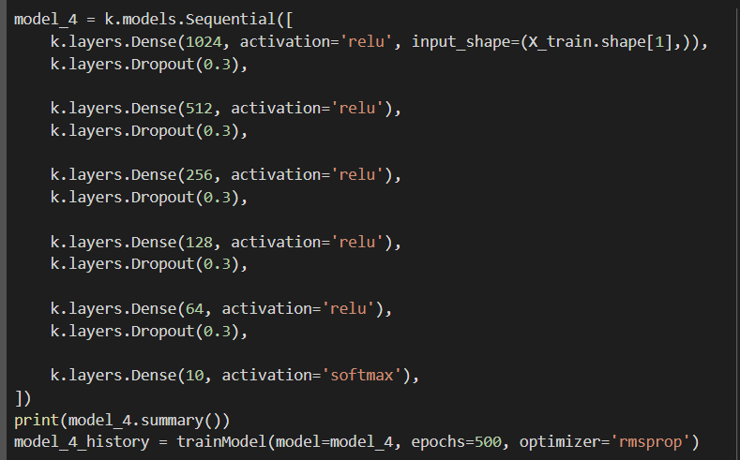
MODEL 4

Slide 42
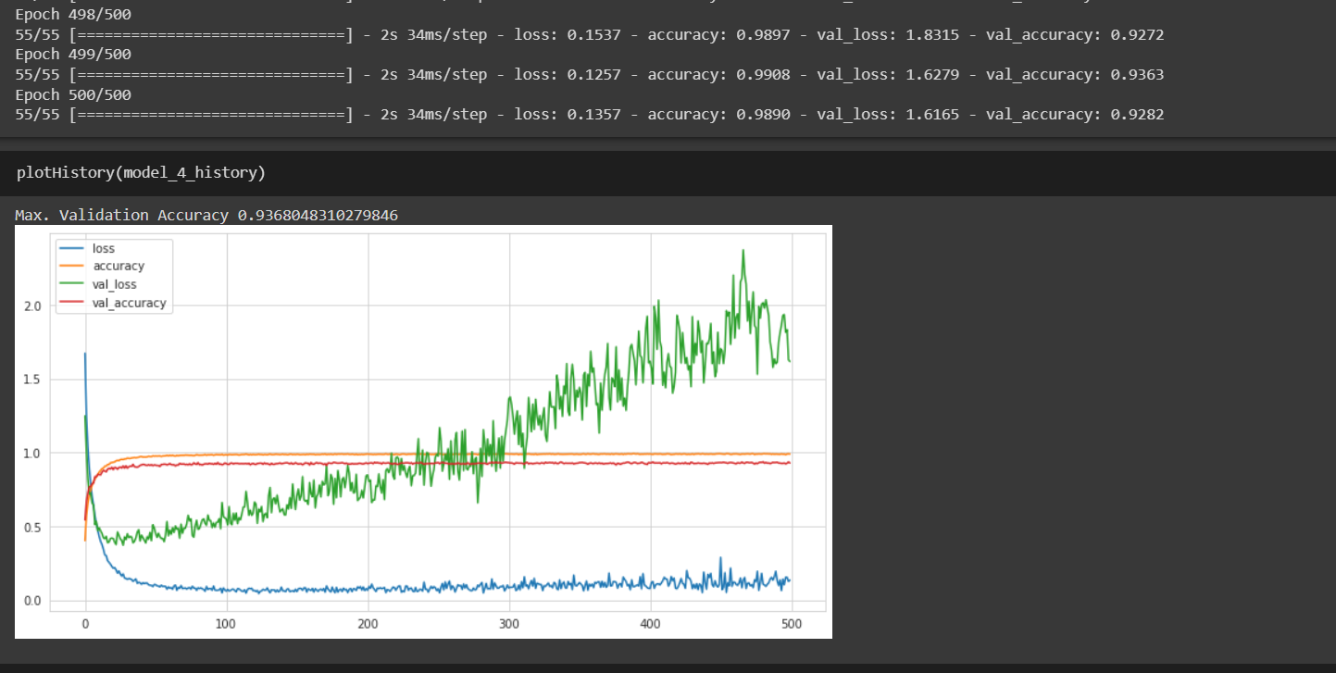
MODEL 4 ACCURACY

Slide 43
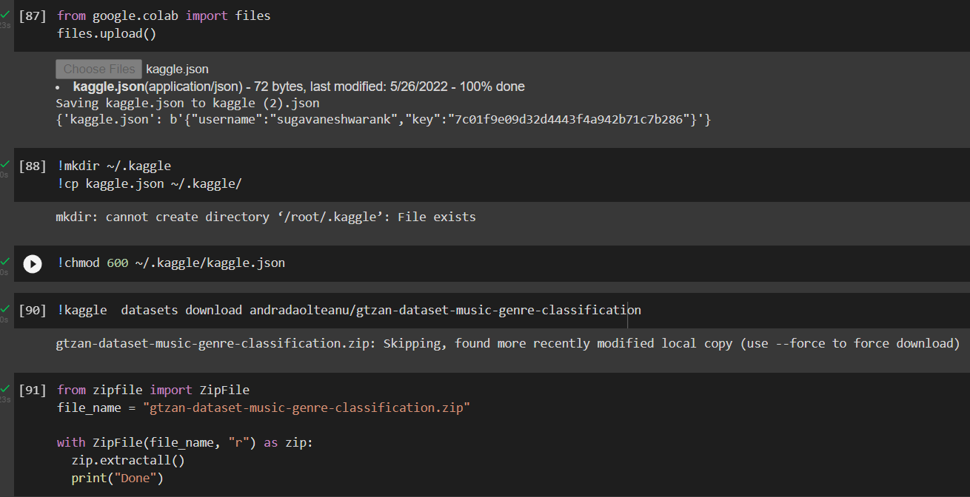
TESTING WITH NEW DATASET

Slide 44
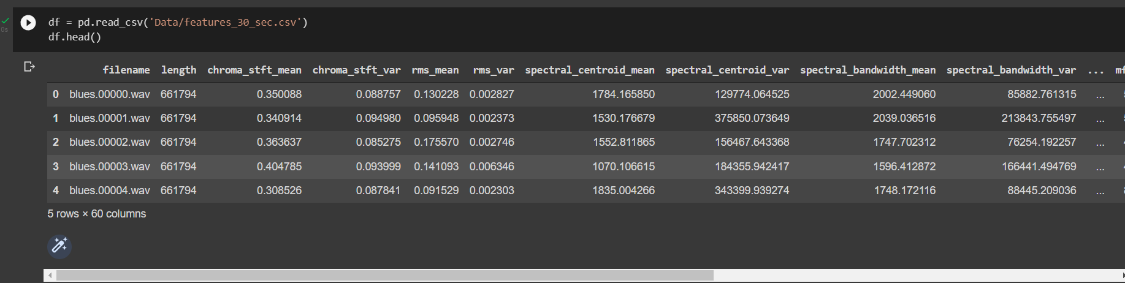
NEW DATASET

Slide 45
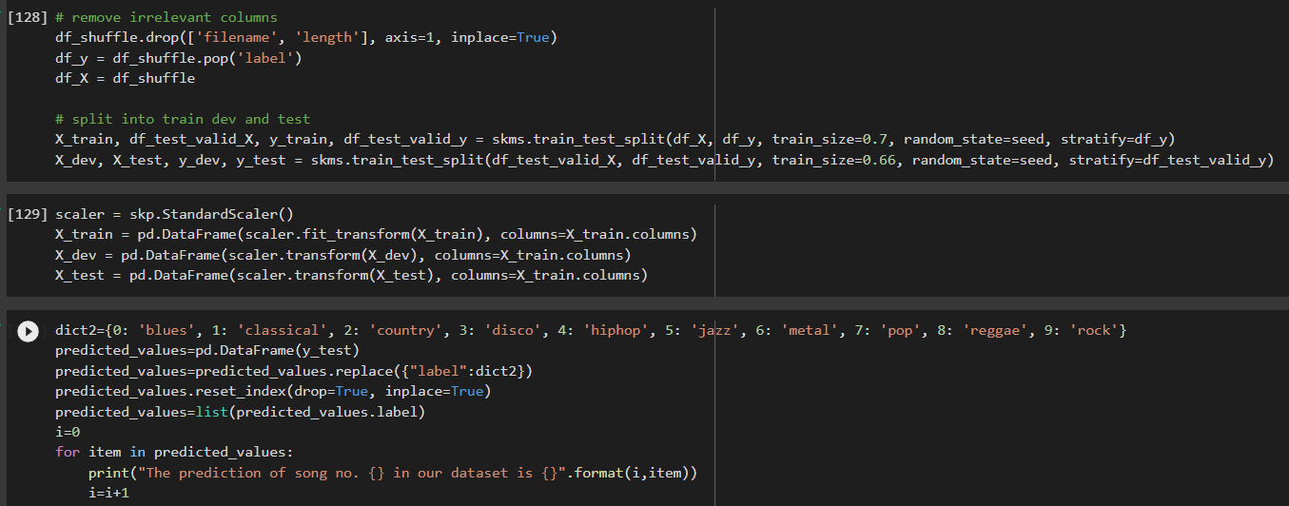
TRAIN & TEST SPLIT

Slide 46
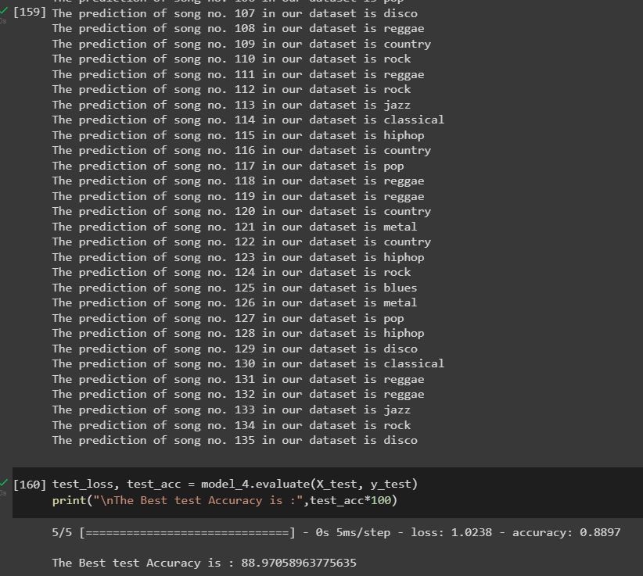
TESTING ACCURACY

Slide 47
EVALUATION METRICS
The three parameters are used to estimate the performance of the model, sensitivity, specificity, and accuracy. Here sensitivity tells us how well our models classify a particular class, and specificity tells us how well our model is classified for non-current class. Accuracy tells us about the overall ratio of correctly detected events. All these parameters are defined as follows:
Sensitivity =TP/(TP+FP)
Specificity =TN/(TN+FP)
Accuracy =(TP+TN)/ Total Events
Here sensitivity and specificity are calculated for each class and accuracy for the overall results. For calculating sensitivity and specificity for a particular class say X,
TP for X is all the X instances that are classified as X
TN for X is all the non-X instances that are not classified as x
FP for X is all the non-X instances that are classified as X positive rate.

Slide 48
REFERENCE
[1] Anirudh Ghildiyal,Komal Singh,Sachin Sharma,2020, Music Genre Classification using Machine Learning,2020 4th International Conference on Electronics, Communication and Aerospace Technology (ICECA).
[2] George Tzanetakis, Perry Cook,2002, Musical Genre Classification of Audio Signals, IEEE Transactions on Speech and Audio Processing( Volume: 10, Issue: 5, July 2002)
[3] Sarfaraz Masood, ,2014, Genre classification of songs using neural networks, Conference: ICCCT-2014 At: MNIT Allahbad
[4] Glaucia M. Bressan, Beatriz C. F. de Azevedo, Elisangela Ap. S. Lizzi 2017, A Decision Tree Approach for the Musical Genres Classification

Slide 49
REFERENCE(Contd…)
[5] Rajib Sarkar; Nimagna Biswas; Saurajit Chakraborty,2018,Music Genre Classification Using Frequency Domain Features, 2018 Fifth International Conference on Emerging Applications of Information Technology (EAIT) [6] Ardiansyah Dores, Fajar Masya, Hendra Prastiawan,2018, Music Genre Classification using Naïve Bayes Algorithm,International Journal of Computer Science and Mobile Computing ISSN 2320–088X
[7] Bisharad, Dipjyoti, and Rabul Hussain Laskar,2019, Music Genre Recognition Using Residual Neural Networks, TENCON 2019 - 2019 IEEE Region 10 Conference (TENCON) [8] Yu-Huei Cheng, Pang-Ching Chang, Che-Nan Kuo,2020, CNN Approach for Music Genre Classification, 2020 International Symposium on Computer, Consumer and Control (IS3C)
[9] Nirmal M R,Shajee Mohan BS,2020, Music Genre Classification using Spectrograms, 2020 International Conference on Power, Instrumentation, Control and Computing (PICC)

Slide 50
THANK YOU
THANK YOU

